Slide 1
Capstone Project - AllianceBernstein
Weekly Update
4.10
Hongyu Dai

Slide 2
Summary - TX data
Handling Missing Values
Drop rows where >50% columns are null
Handling Missing Values for 4-Year Longitudinal Rate Element
Filling Missing 2020 data
Rolling Average
Mean
Pct change
Corrlelation analysis
Modelling
LinearRegression
RandomForestRegressor

Slide 3
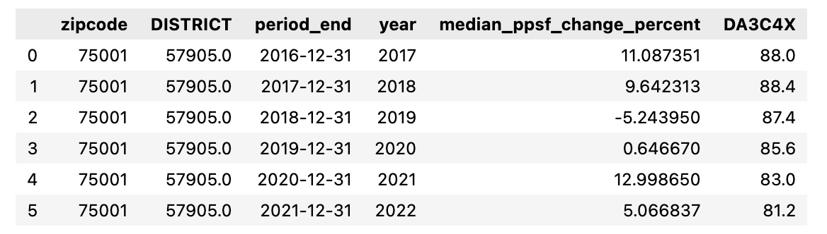
Handling Missing Values for 4-Year Longitudinal Rate Element
The "4-Year Longitudinal Rate (Gr 9-12)" element covers data from 2016-2021
For each district, we will perform forward and backward filling to fill missing values in years where data was not collected
This will allow us to recover missing TAPR 20-year data for analysis

Slide 4
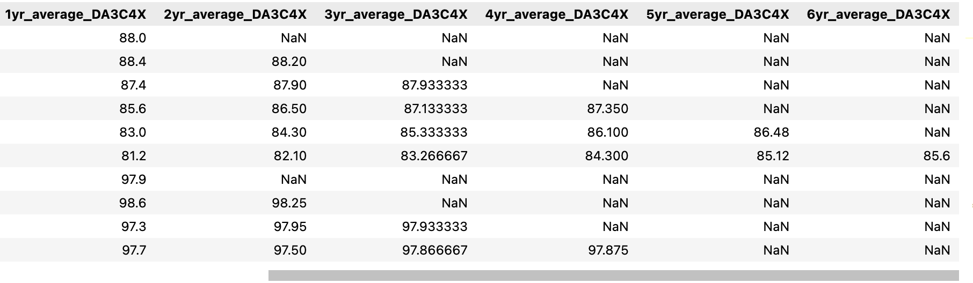
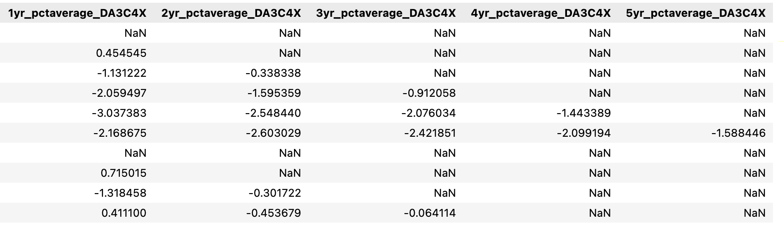
Adding Rolling Average
We will generate two types of datasets: mean and percent change
The mean dataset will provide the average value for each feature over a specified time window
The percent change dataset will provide the percentage change in value for each feature over a specified time window
We will use both datasets for correlation analysis and modeling

Slide 5
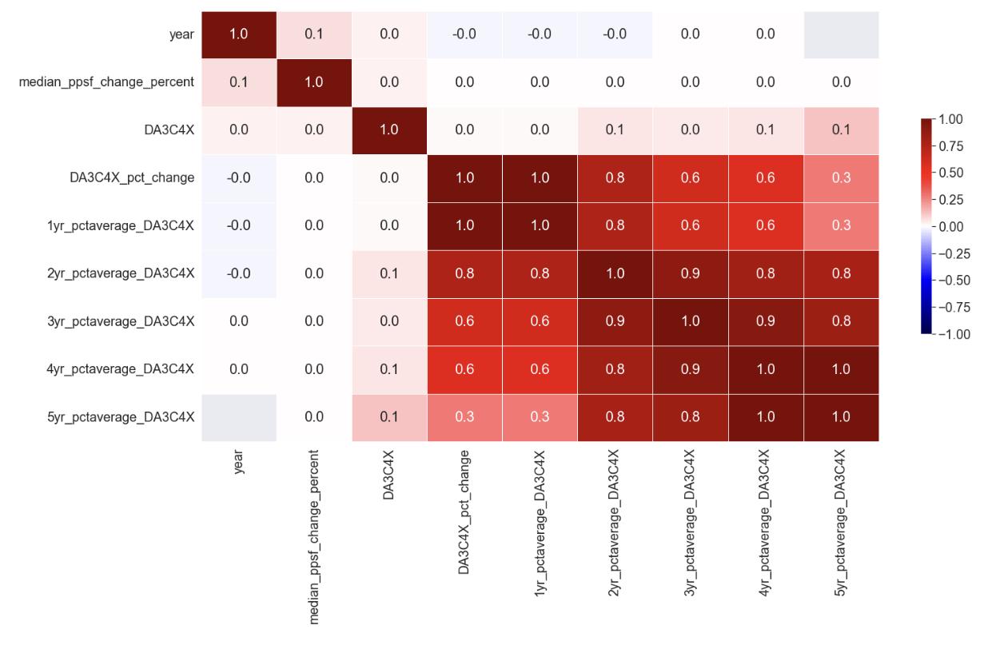
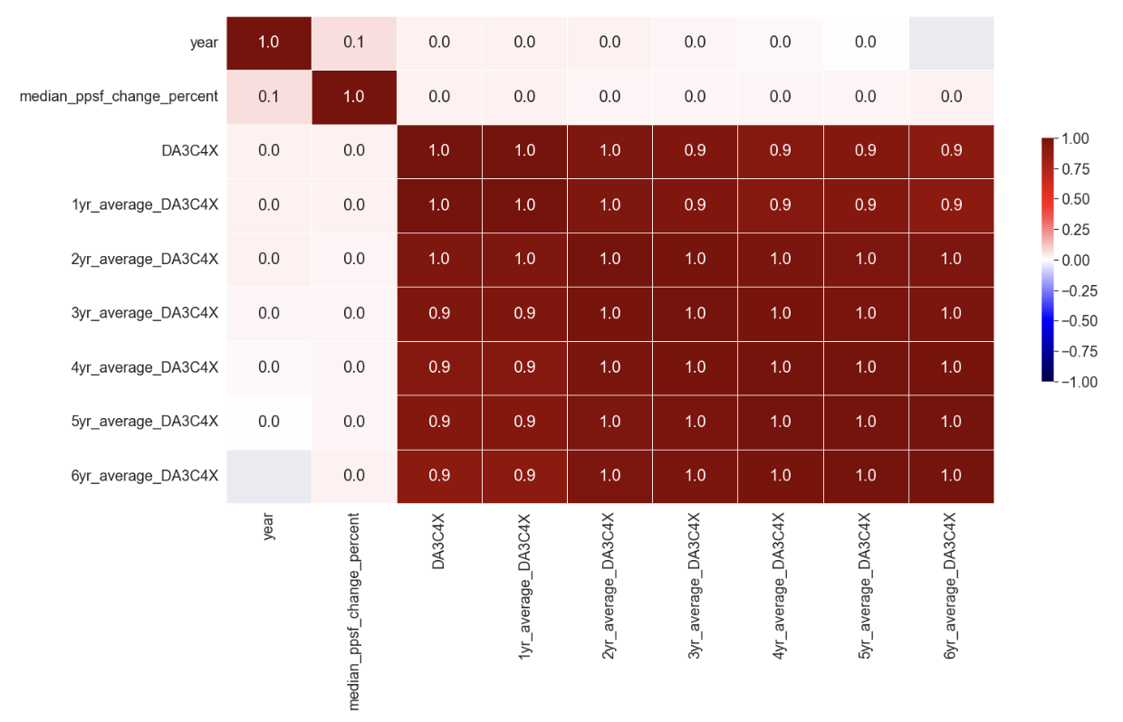
Correlation Analysis
We will perform correlation analysis to understand the relationship between different variables in the dataset
Based on the correlation analysis, we found that there is no correlation between individual variables, so we will use a combination of variables for modeling

Slide 6
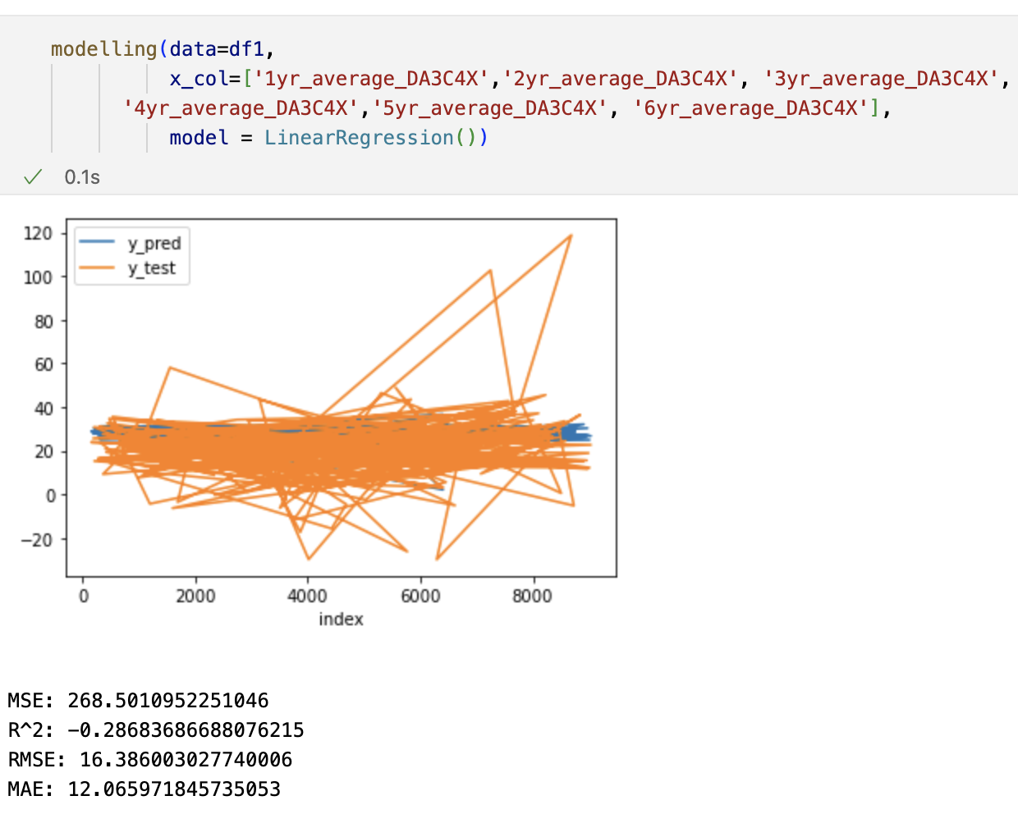
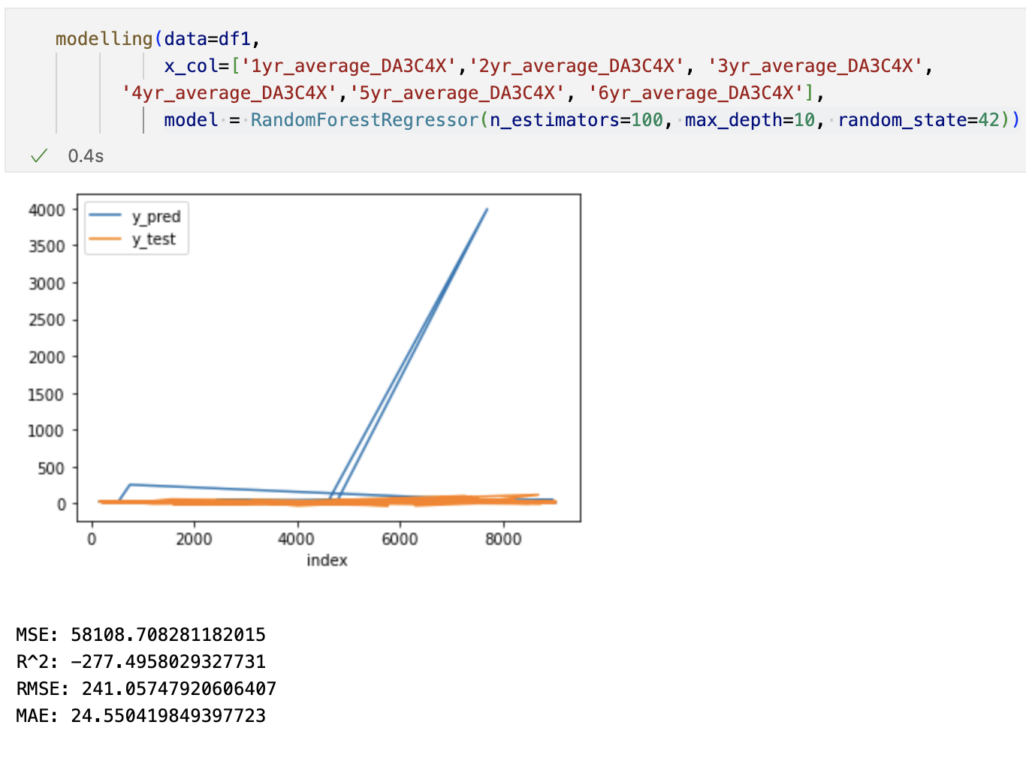
Modeling - RandomForestRegressor & LinearRegression for mean

Slide 7
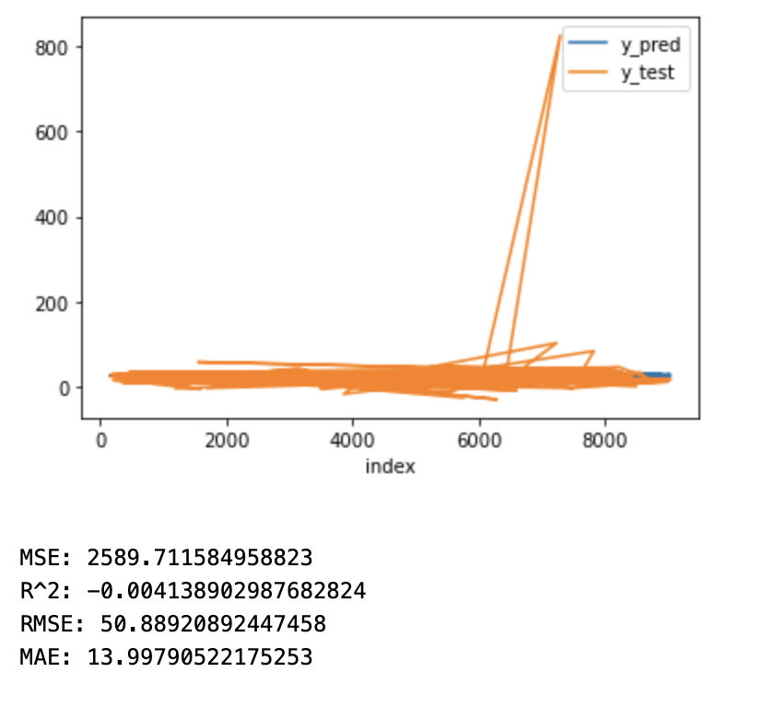
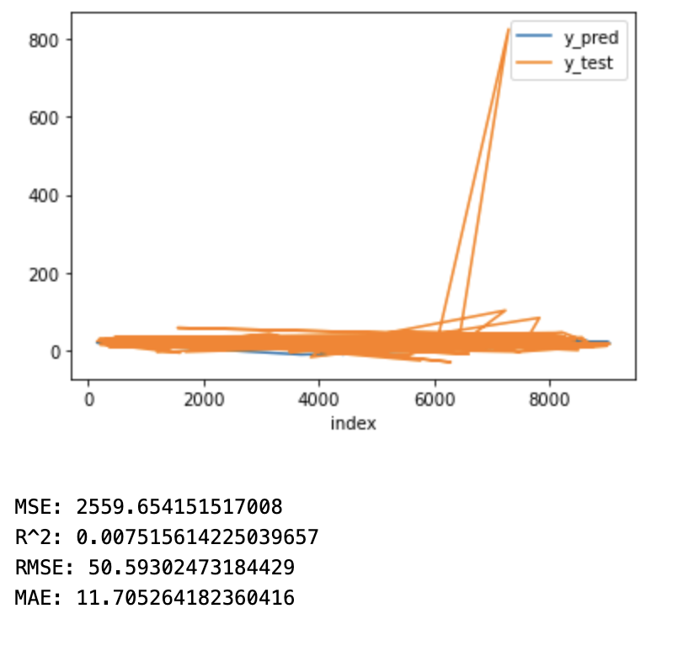
Modeling - RandomForestRegressor & LinearRegression for pct change

